Slide 1

HDS Tutorial 1 Week 2

Slide 2
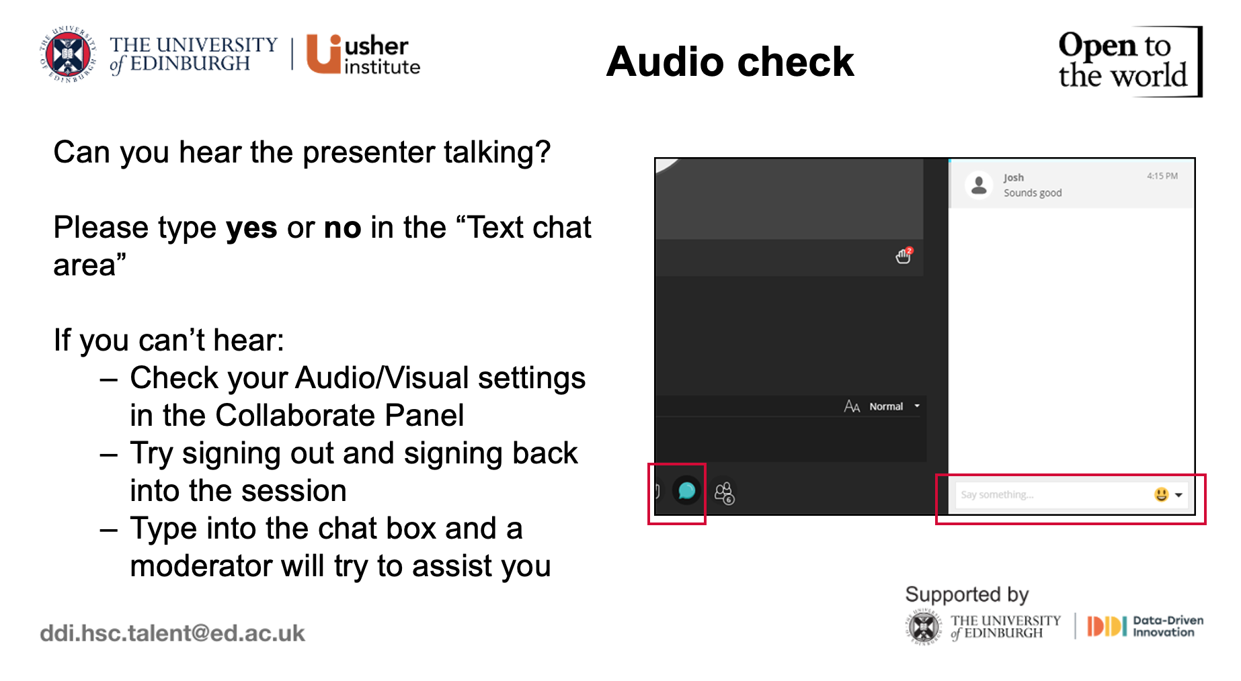

Slide 3


Slide 4
HDS Tutorial 1 Week 2

Slide 5

Agenda
What is R
Why use R
Example data flow presentation using health data
Tips for starting out with R
How to search for help online
Q&A

Slide 6
Has everyone downloaded R/R Studio? Or are you using Noteable?

Slide 7

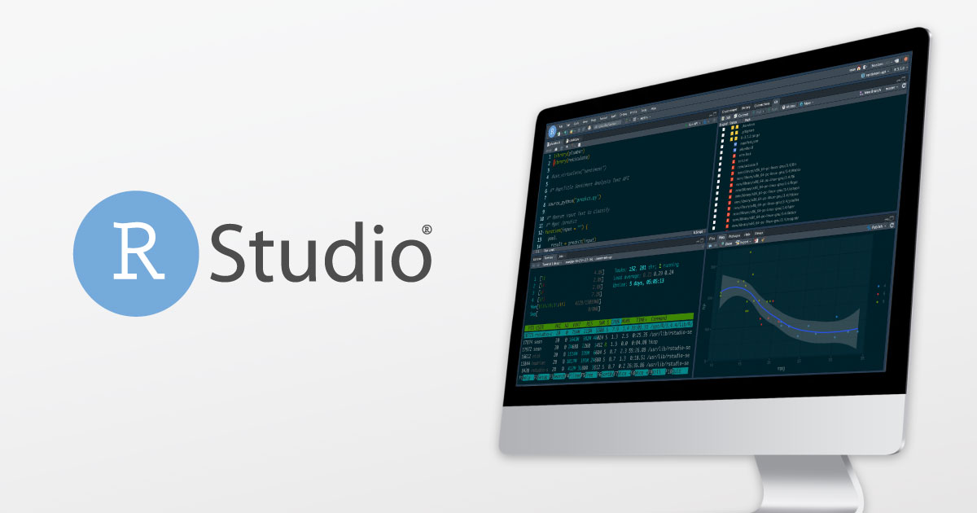
Organisations behind R
The R Project
Comprehensive R Archive Network (CRAN)
R Studio

Slide 8
What are some of the reasons you want to learn R? What benefits have you heard over other programming languages?

Slide 9
Advantages
“Open source” software
Free (!!)
New methods implemented faster
More flexible/customizable
Anyone can contribute
Do not have to work at R to contribute to R
Disadvantages
No centralized support
Many find it harder to learn - but that is why we are here!
Less consistency across procedures
other software you rely on the programmers
…anyone can contribute (some packages are far better than others)

Slide 10
Further Reasons for Why R…
High quality and robust data visualization
e.g., ggplot2 — covered in depth in Week 4
Go-to language for statistics and data science; used in almost every industry
Vast R community support
Stack Overflow !
Twitter Rstats
etc.
The most comprehensive statistical analysis package new technology & ideas often appear first in R
tidyverse
RMarkdown (covered in Week 6)
you can do so many things beyond data analysis/processing… maps, calendars, etc.!
It can be very satisfying and fun once you get the hang of it!

Slide 11

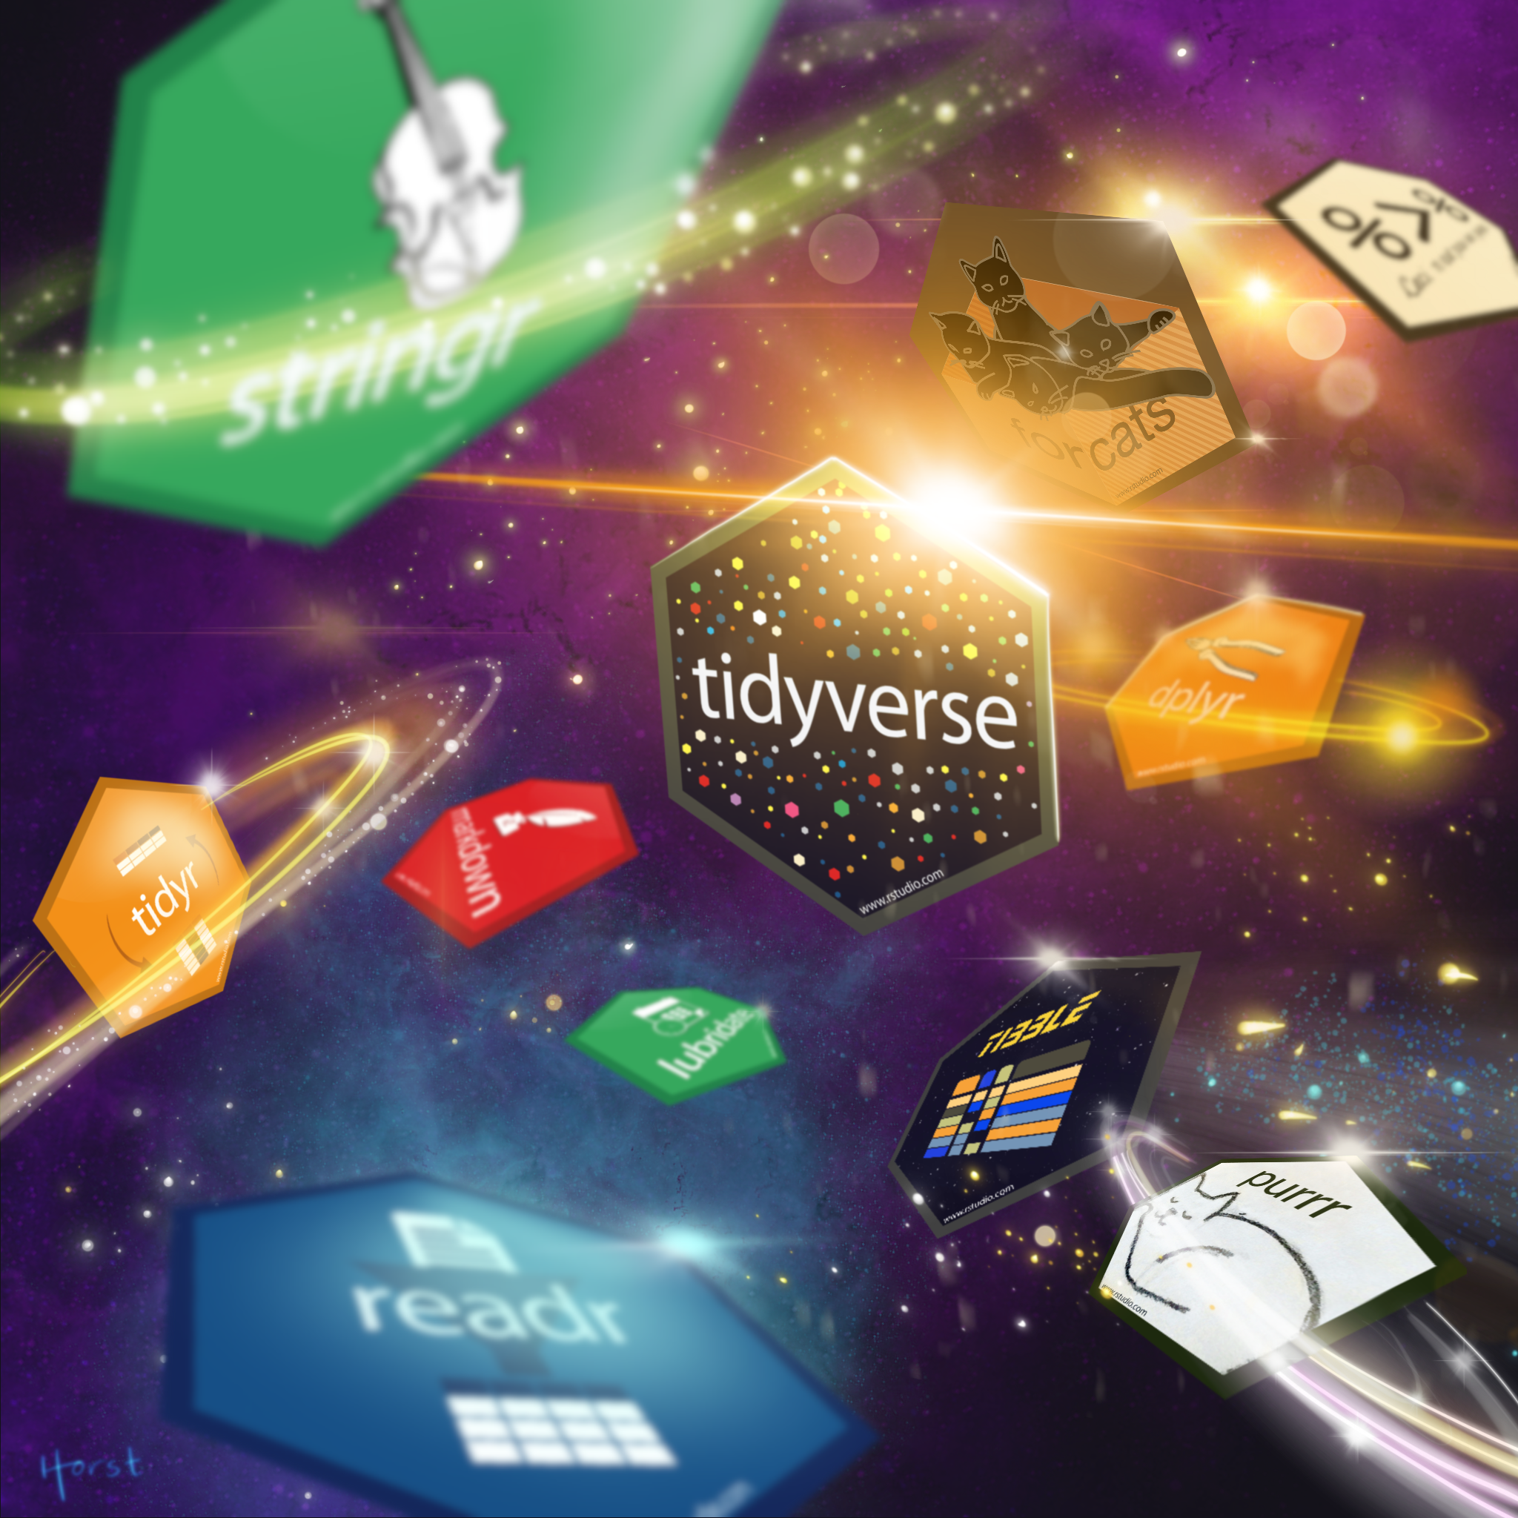
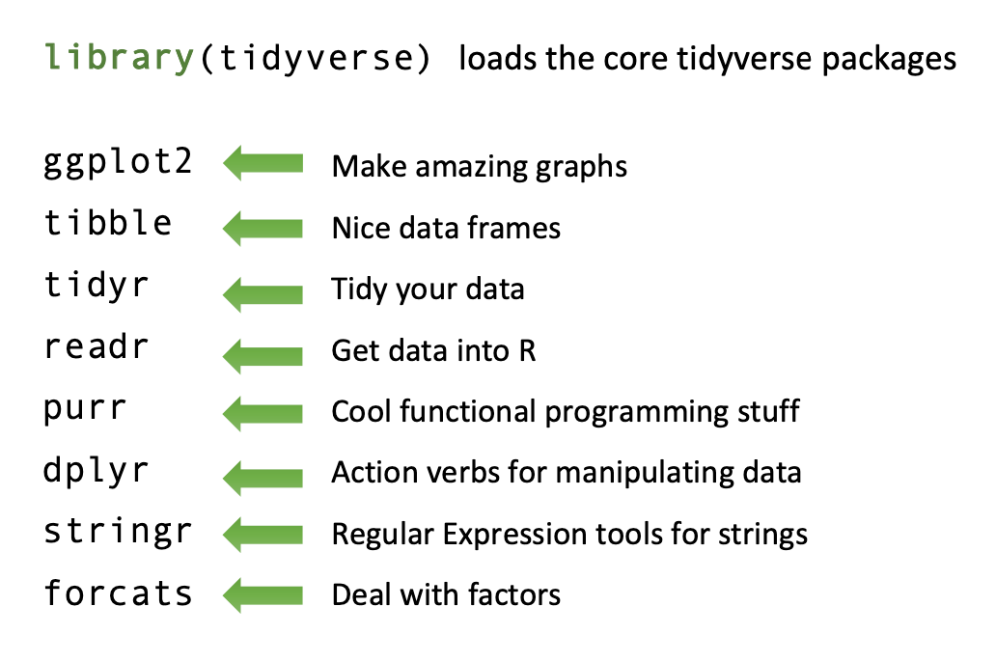
Formalized set of packages and tools that have a consistently structured programming interface
as opposed to base R, which is more complex/varied and less user friendly
Into the Tidyverse!
streamlined data wrangling & visualization

Slide 12
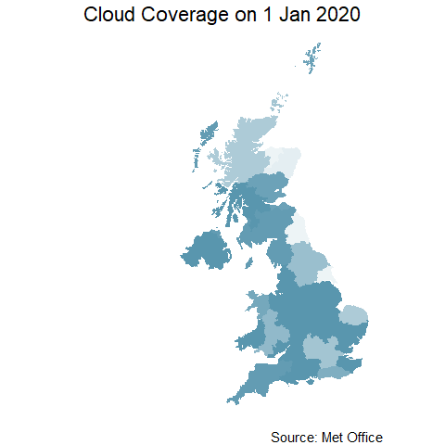
An animation example
An example of:
the power of data visualization in R
what HDS is building you towards
Animation (gganimate package) with maps (sf package) and Met Office data

Slide 13

R Syntax
There are 3 main different types of syntax you might come across:
1. base R ($)
2. tidy verse (%>%)
3. formula (~)

Slide 14
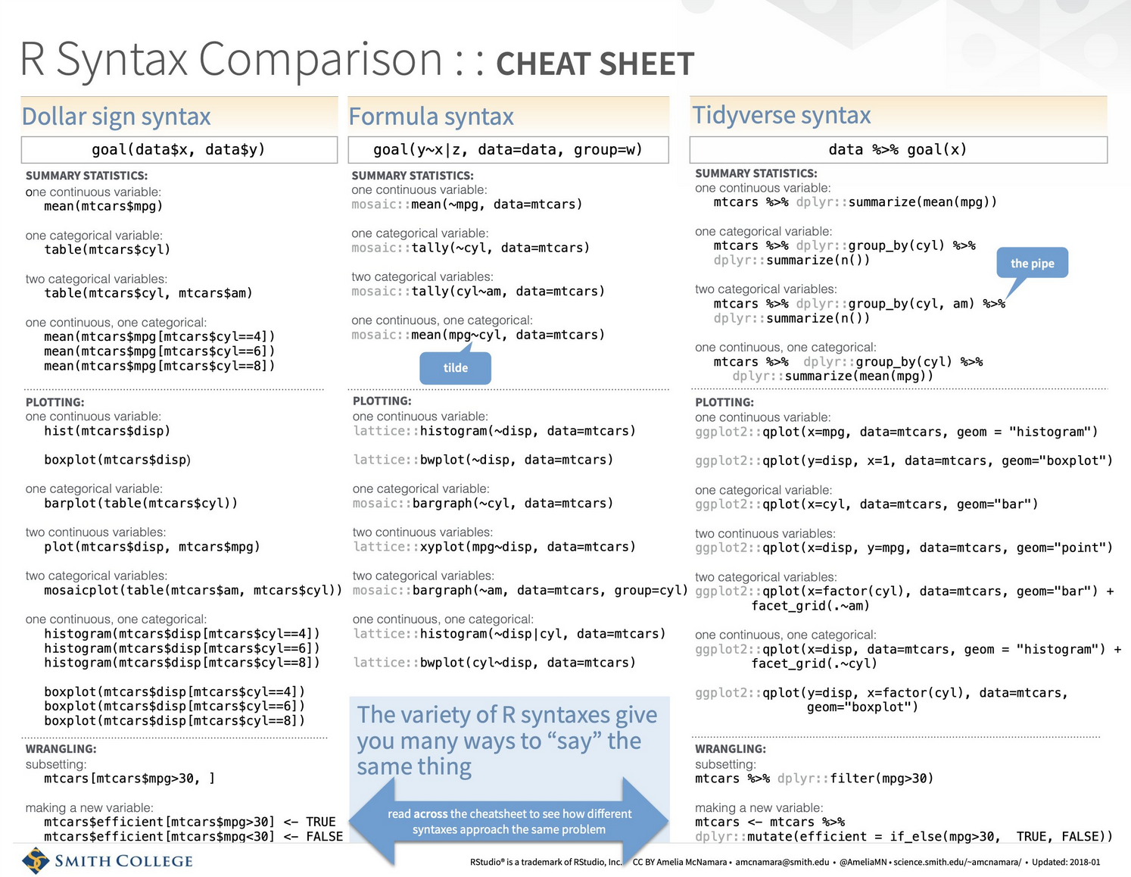
last updated 2018, needs some updating
credit to Amelia McNamara
Full cheat sheet here

Slide 15
Bar chart demonstration in R using heath care data

Slide 16
Tips to start out with R
Add comments to your code if using script
Use a # at the beginning of the line or at the end of the line
You can also add sections to your script code
At the end of a section add 4 dashes - or 4 hashes #
Avoid dots and spaces in variable names
instead used capital letters or underscore
Check Cheatsheets, especially when using a new package
Top menu Help > Cheatsheets or https://rstudio.com/resources/cheatsheets/
If you are unsure of what something does, type into the console a question mark followed by the function or package
>?function
for common functions, check the introverse package documentation
General introduction to R as a programming language: A Succinct Intro to R
Always load packages at the start of a script
Make sure everything is spelled correctly! and capitalization is consistent when loading in data
Practice makes perfect. Build familiarity with the system and don’t be afraid to make mistakes
When in doubt, Google it!!

Slide 17
Have you looked for R help online? If so, was it effective? What did you type in?

Slide 18
How to effectively search for help online:
when in doubt, copy and paste an error into google
include the package name or “in R” in your search
built-in R help function >?function
StackOverflow
RStudio Community
Be willing and ready to adapt code to your context
Holly has a lovely document with more details

Slide 19
Questions?

Slide 20
Some helpful definitions…

Slide 21
Working Directory
After installing R & RStudio, you need to set the working directory
This is the location on your computer where any data files to imported can be found, and where any R scripts (the files that save your code) will be saved
In R studio, you can set the working directory with the menus (Session >> Set Working Directory >> Choose Directory) or with a line of code that gives the path of the folder on your computer:
>setwd(“Drive:/Folder1/Folder2”)
If you have made a new R Project from an existing Directory as shown in the live demo, working directory will be set this way
can always check working directory with the function:
>getwd()

Slide 22
Some vocabulary
Function = how you get stuff done in R (chapters in metaphor)
Argument = specifications of functions (specific pages in metaphor)
Packages = are a collection of R functions, complied code and sample data. By default a set of packages are installed during installation. They are stored under a directory called "library" in the R environment (books in metaphor)
Documentation = the explanations of functions and arguments for different packages written by the authors (glossary in metaphor)
“run” or “running code” = enter command into the R console to make it happen
Script = a text file containing (almost) the same commands that you would enter on the command line of R
Data frame = a special type of list where every element of the list has same length (i.e. data frame is a “rectangular” list); de facto data structure for most tabular data and what we use for statistics.
Tibble = tidyverse style dataframe
Indexing = selecting a subset of the elements in order to use them in further analysis or possibly change them. Style depends on syntax (see slide 13 + cheat sheets)

Slide 23
Variable Types in R
character: "a", “swc"
numeric: 2, 15.5
“continuous” variable in other software
integer is similar, use numeric in practice (less limitations)
double is similar, but is a numeric value with decimal places
logical: TRUE, FALSE
complex: 1+4i (complex numbers with real and imaginary parts)
factor: used to describe items that can have a finite number of values (gender, social class, etc.).
A factor has a levels attribute and class "factor"
Optionally, it may also contain a contrasts attribute which controls the parametrization used when the factor is used in a modeling functions.
“categorical” variable in other software. Tell R that a variable is nominal by making it a factor. An ordered factor is used to represent an ordinal variable.

Slide 24
Data Structures in R
Vectors = most common and basic structure in R; a collection of elements that are most commonly of mode character, logical, integer or numeric.
Atomic vector = vector where elements much be the same data type; default vector type
List = a special type of vector. Each element can be a different type.
Matrix = an extension of the numeric or character vectors. They are not a separate type of object but simply an atomic vector with dimensions; the number of rows and columns. As with atomic vectors, the elements of a matrix must be of the same data type.
Array = similar to matrices but can have more than two dimensions
Data frame = a special type of list where every element of the list has same length (i.e. data frame is a “rectangular” list); de facto data structure for most tabular data and what we use for statistics

